Slide 1
Chapter 5 (Tanenbaum)
Network Layer

Slide 2
Layers?
Convert frame to packet.
Convert bit stream to frame.
Compute Checksum.
If source & receiver checksum is not equal, discard it.
Network Layer
Data Link Layer
If channel is noisy, add some extra bit to reduce error rate.
Bits may be less or grater than actual bits
Taking raw bit stream form physical layer
Physical Layer
Take input from wire/wireless medium.
Convert signal to raw bit stream.

Slide 3
Network Layer Design Issue
Store-and-Forward Packet Switching
Services Provided to the Transport Layer
Implementation of Connectionless Service
Implementation of Connection-Oriented Service
Comparison of Virtual-Circuit and Datagram Subnets

Slide 4
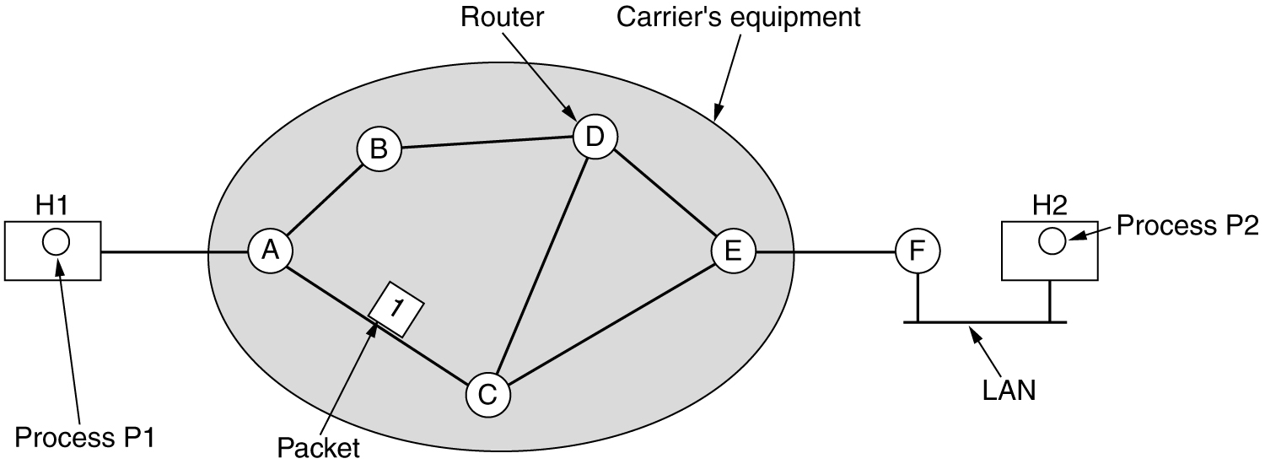
Store-and-Forward Packet Switching
The environment of the network layer protocols.

Slide 5
Store-and-Forward Packet Switching (1)
A host with a packet to send transmit it to the nearest router, either on it’s own LAN or over a point-to-point link to the ISP.
The packet is stored there until it has fully arrived and the link has finished its processing by verifying the checksum.
Then it is forwarded to the next router along the path until it reaches the destination host, where it is delivered.
Notes:
https://www.youtube.com/watch?v=k8rJFgeuZRw

Slide 6
Services Provided to the Transport Layer
An important question is precisely what kind of
services the network layer provides to the transport layer?
Dealing with the following goals in mind:
The services should be independent of the router technology.
The transport layer should be shielded from the number, type, and topology of the routers present.
The network addresses made available to the transport layer should use a uniform numbering plan, even across LANs and WANs.

Slide 7
Services Provided to the Transport Layer
An important question is precisely what kind of
services the network layer provides to the transport layer?
Service Kinds:
Connectionless Service: Internet Community.
The hosts should accept the fact that the network is unreliable, so need to do error control (i.e., error detection and correction) and flow control themselves.
Connection-Oriented Service: Telephone companies.
Network should provide a reliable, connection-oriented service. (ATM)

Slide 8
Services Provided to the Transport Layer
Service Kinds:
Connectionless Service: Internet Community.
Connection in unreliable.
Host does the error control (i.e., error detection and correction) and flow control themselves.
There is no packet ordering. Because host are going to do flow control already.
Furthermore, each packet must carry the full destination address, because each packet sent is carried independently of its predecessors, if any.

Slide 9
Services Provided to the Transport Layer
Service Kinds:
Connection-Oriented Service: Telephone companies.
Network should provide a reliable, connection-oriented service. (ATM-Asynchronous Transfer Mode)
Quality of service is the dominant factor. Quality of service is very difficult to achieve, especially for real-time traffic such as voice and video.

Slide 10
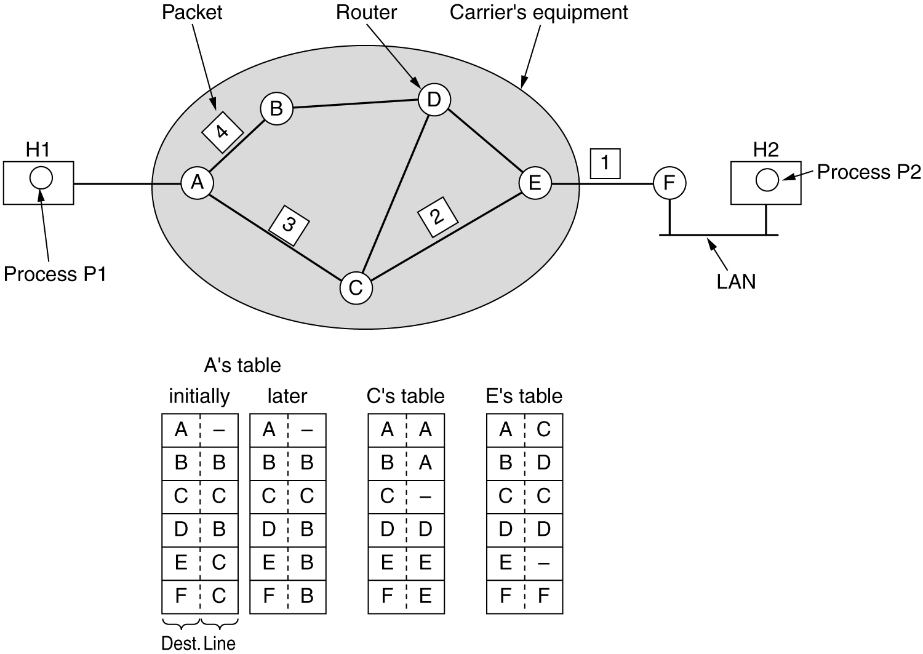
Implementation of Connectionless Service
Packets are injected into the network individually and routed independently of each other.
No advance setup is needed.

Slide 11
Implementation of Connectionless Service
Packet frequently called as datagram.
The network is called a datagram network.
Routing within a diagram subnet.

Slide 12
Implementation of Connectionless Service
Routing within a diagram subnet.

Slide 13
Implementation of Connection-Oriented Service
In connection-oriented service a path from the source router all the way to the destination router must be established before any data packets can be sent.
This connection is called a VC (virtual circuit).
The network is called a virtual-circuit network.

Slide 14
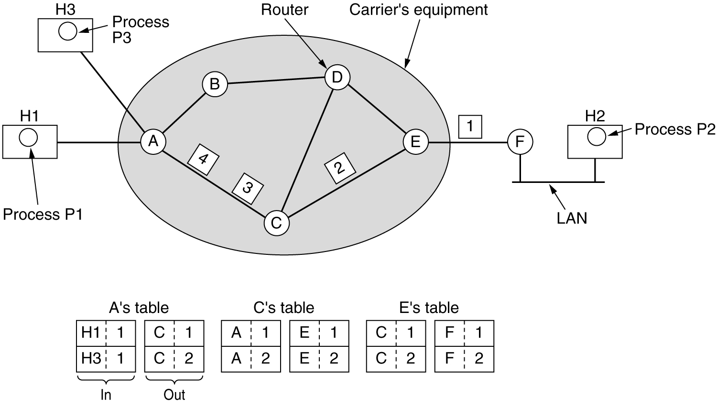
Implementation of Connection-Oriented Service(1)
Routing within a virtual-circuit subnet.

Slide 15
Implementation of Connection-Oriented Service(2)
Host H1 has established connection 1 with host H2.
This connection is remembered as the first entry in each of the routing tables.
What happens if H3 also wants to establish a connection to H2?
Normally It chooses connection identifier 1 [but 1 is already used]. That’s the problem!!!
So have to choose different connection identifier I,e 2.
This process is called label switching.

Slide 16
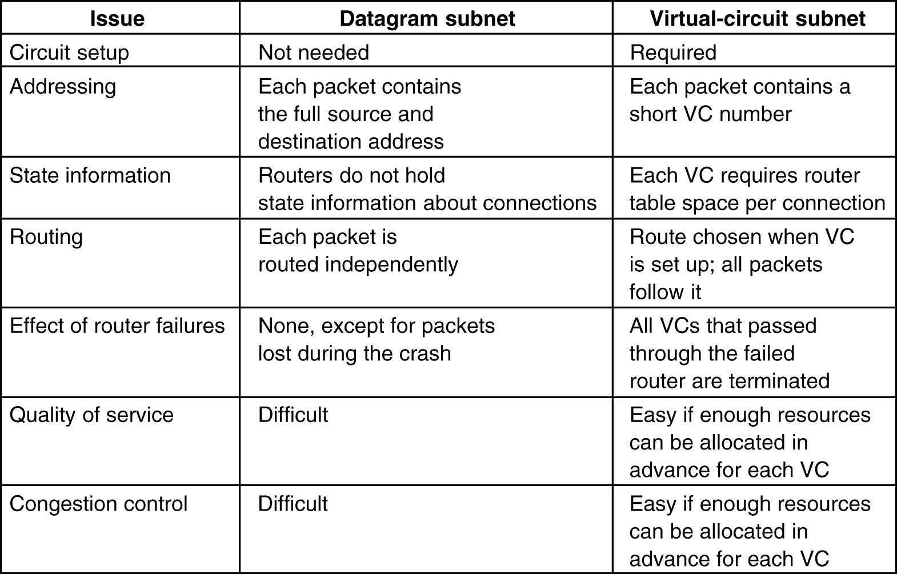
Comparison of Virtual-Circuit and Datagram Subnets

Slide 17
Routing Algorithms
Main function of Network Layer:
The main function of the network layer is routing packets from the source machine to the destination machine.
Process inside Router:
Forwarding: handles each packet as it arrives, looking up the outgoing line to use for it in the routing tables.
Routing: Determines route taken by packets form the source machine to the destination machine ( Routing algorithm)
Routing Algorithms:
The routing algorithm is that part of the network layer software responsible for deciding which output line an incoming packet should be transmitted on.

Slide 18
Routing Algorithms
Network Layer Software responsible for deciding which output line an incoming packed should be transmitted on. If the network layer use-
Datagrams: require computation of decision making tables for every arriving data packet.
Virtual Circuit: routing decision are made only when a new virtual circuit is being set up.
Session Routing: data packets follow the same routing for the entire session.

Slide 19
Routing Algorithms
Desired properties of Routing Algorithm:
Correctness (Before we adopt any algorithm we need to make sure that it has been tested enough and it is functioning correctly)
Simplicity (Algorithm should be less complex)
Robustness (The routing algorithm should be able to cope with changes in the topology and traffic without requiring all jobs in all hosts to be aborted)
Stability (Converge to a fixed set of paths)
Fairness (No device or link has to be compromised)
Optimality (Converge to provide optimal throughput)

Slide 20
Network Performance Measures
Two Performance Measures
Quantity of Service (Throughput)
How much data travels across the net?
How long does it take to transfer long files?
Quality of Service (Average packet delay)
How long does it take for a packet to arrive at its destination?
How responsive is the system to user commands?
Can the network support real-time delivery such as audio and video?

Slide 21
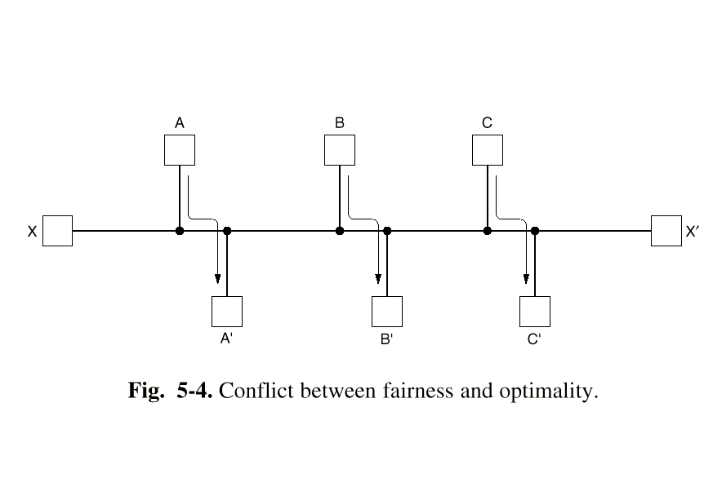
*Fairness versus Optimality
Quantity of service (fairness) versus quality of service (optimality).
To optimize throughput, saturate paths between A and A’, B and B’, and C and C’, but what happens to the response time from X to X’?
Notes:
An optimally functioning network is one that provides the highest quality of service possible, but this often comes at the cost of fairness, as some users or applications may receive more resources or better service than others. quantity of service provided, and it is often concerned with ensuring fairness in the distribution of resources, such as bandwidth or processing time, among different users or applications.

Slide 22
*Fairness versus Optimality/Efficiency
There is enough traffic between A and A’, between B and B’, and between C and C’ to saturate the horizontal links. To maximize the total flow, the X to X′ traffic should be shut off altogether. So it’s not fair for X to X’ link. So fairness drops but optimum output is achieved.

Slide 23
Routing Algorithms
Routing algorithms can be grouped into two major classes:
1. Nonadaptive and
2. Adaptive.
Nonadaptive algorithms the choice of the route to use to get from source to destination is computed in advance. Static
Adaptive algorithms, in contrast, change their routing decisions to reflect changes in the topology, and sometimes changes in the traffic as well. Dynamic

